Slide 1


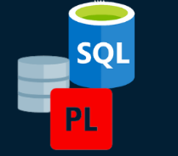
NAMES: TURIKUMANANJEAN CLAUDE
ID :26989
GROUPE :MONDA (A)
POJECT:Business Interaction Manager (BIM)

Slide 2

Problems
1
2
3
Issue
Context
Users Affected
Businesses lack a structured system to track client interactions, follow-ups, staff activities, and communication history. This results in missing information, delayed responses, and difficulty monitoring performance..
Organizations rely on multiple tools (email, calls, spreadsheets), causing scattered data and no unified view of interactions. Important actions are lost, auditing is difficult, and decision-making is slowed.
Business Managers: Cannot monitor staff performance or client engagement.
Staff Members: Struggle to track follow-ups and client history.
Clients: Experience delays, inconsistent communication, and reduced service quality.

Slide 3
Solution
Centralize all client interactions in one structured database.
Improve follow-up tracking and accountability.
Enable secure, auditable, and efficient business communication management.
Objectives:
Scope:
Covers client records, staff records, interactions, follow-ups, and action tracking.
Includes audit logging, holiday/date restrictions, and secure triggers.
Supports staff operations, reporting, and administrative controls.
Key Features:
Client & staff management,Interaction & follow-up tracking,Automated audit logs,Holiday restriction validation,Simple & compound security triggers,Data integrity and validation functions

Slide 4
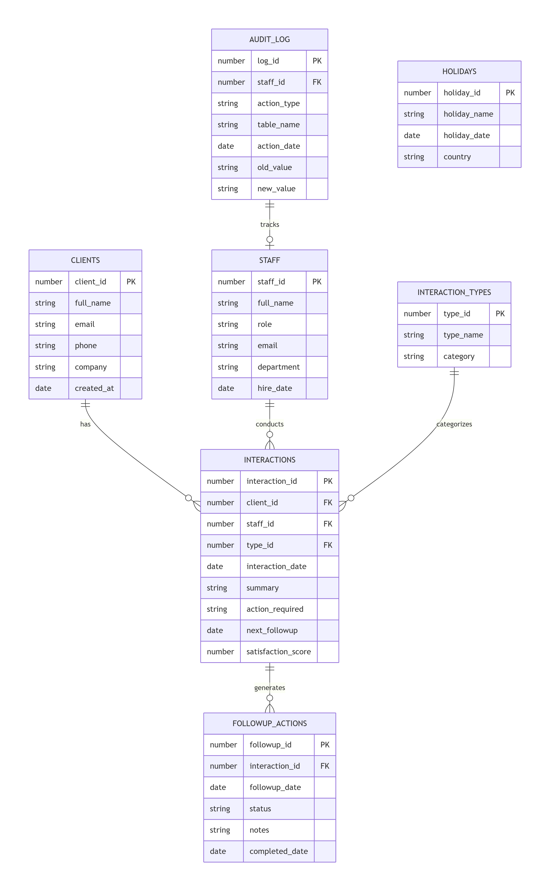

Database (ER diagram, entities)
entities
ER diagram
CLIENTS
STAFF
INTERACTION_TYPES
INTERACTIONS
FOLLOWUP_ACTIONS
HOLIDAYS
AUDIT_LOG

Slide 5

Business Process
Swimlanes
Workflow
Client – Requests service, provides information, receives follow-ups.
Staff Member – Records interactions, updates follow-ups, completes required actions.
System (Database) – Validates data, applies restrictions, logs events, automates triggers.
Administrator – Manages users, holidays, security rules, and audits.
Client Request → Client provides details to Staff.
Interaction Recording → Staff enters interaction; system validates & logs.
Follow-Up Scheduling → Staff records next steps; system checks holidays & policies.
Audit Logging → System automatically inserts audit data for every change.
Action Execution → Staff completes follow-ups and updates status.
Administrative Oversight → Admin reviews logs, manages restrictions, and updates settings.

Slide 6
Technical Overview (Technology & PL/SQL)
Technology Stack
PL/SQL
Oracle Database 21c – Core data storage and relational management
Oracle SQL Developer – Development, debugging, and schema management
Triggers & Packages – Automated business rules and modular logic
Stored Procedures & Functions – Insert, update, delete, and validation logic
Exception Handling – Safe error reporting and fail-safe operations

Slide 7
Advanced Features (Triggers, Auditing, Security)
1
2
3
Triggers
Auditing
Security
Prevent INSERT/UPDATE/DELETE on weekdays.
Block actions during public holidays.
Compound triggers manage row- and statement-level logic
Audit log table capturing user, action, timestamp, status
Audit function records success/denial events
Tracks rule violations and compliance trends
Role-based access to administrative operations
Validation functions to prevent bad/invalid data
Error handling ensuring safe, consistent database behavior

Slide 8
BI & Analytics (Dashboards, KPIs, Reports)
Client Interaction Dashboard – daily interactions, follow-up workload, pending tasks
Staff Performance Dashboard – interactions handled, response time, follow-up completion rate
Business Activity Dashboard – busiest periods, interaction types, client categories
Dashboards:
KPIs (Key Performance Indicators):
Average response time
Number of interactions per staff per week
% of overdue follow-ups
Client satisfaction score
Interaction-to-conversion ratio
Weekly activity report
Monthly staff productivity report
Follow-up compliance report
Audit and security report (trigger-based)
Client lifecycle report (new → active → closed)
Reports:

Slide 9
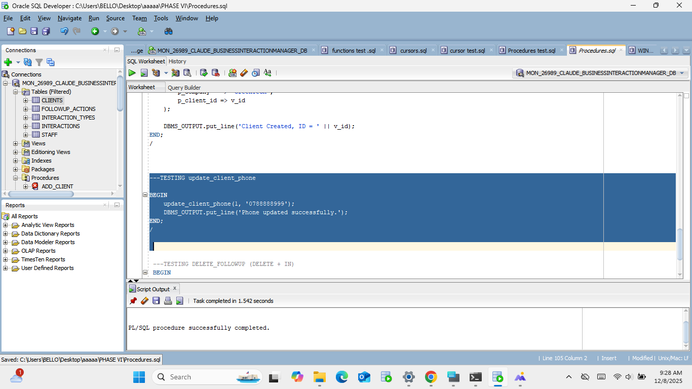
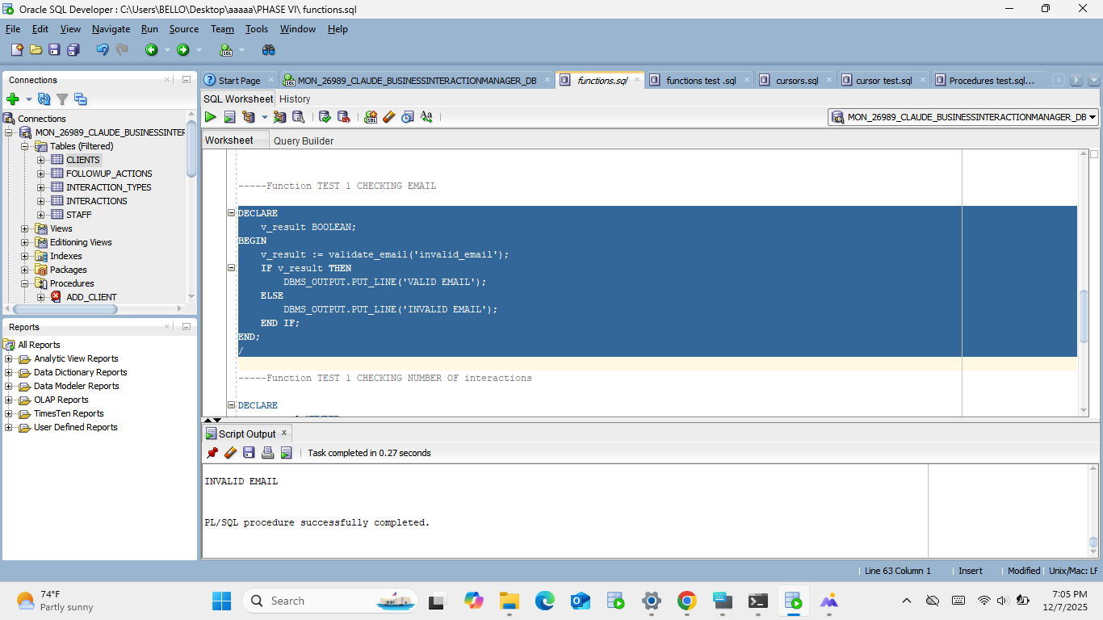
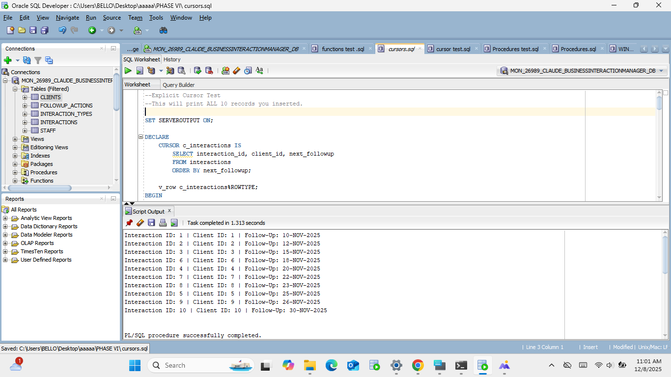
procedure :update
RESULT
function :checking emeil
Cursor follow_up

Slide 10


Conclusion
Achievements
Designed and implemented a complete Business Interaction Management System.
Built fully relational database with triggers, auditing, packages, procedures & security rules
Developed BI dashboards, KPI definitions, analytical queries
Ensured data integrity, automation, and compliance with business rules
Lessons
Importance of data consistency, referential integrity, and transaction control
How PL/SQL automation improves workflow efficiency
Value of auditing and security in enterprise systems
Power of BI/analytics for organizational decision-making
Thank you for your attention

